Slide 1

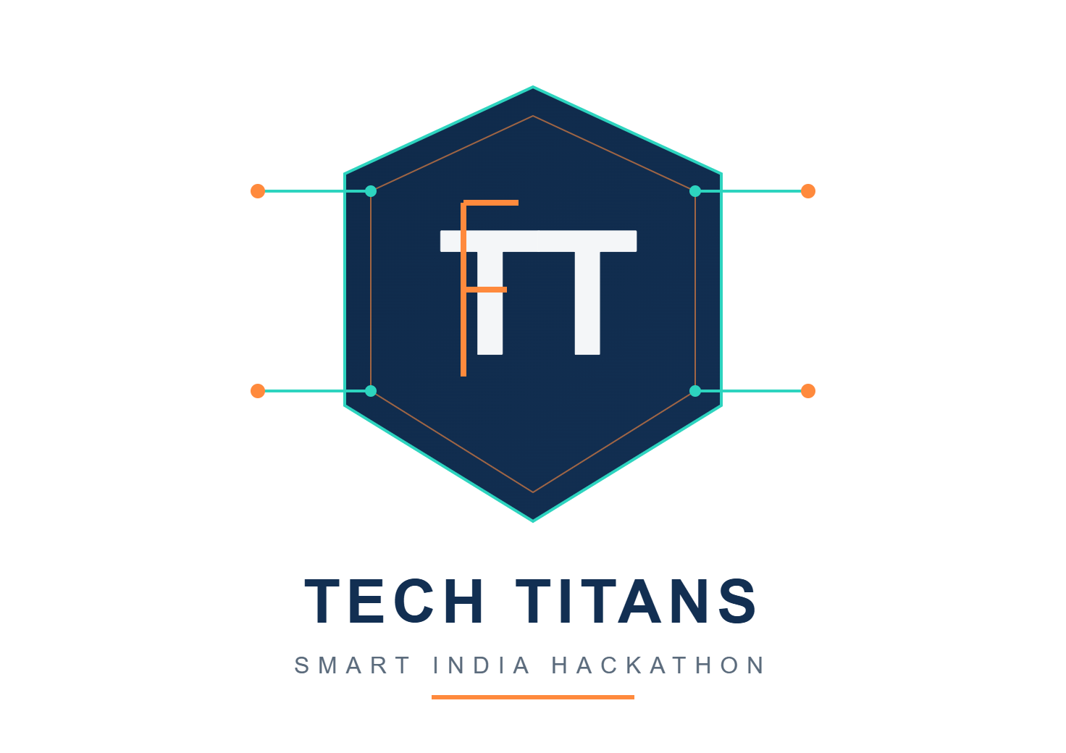

SMART INDIA HACKATHON 2026
DRIFT- Don’t wander, arrive!
Problem Statement ID - 26044
Problem Statement Title - Portal for Academia : Industry Collaboration
Theme - Smart education
Team ID: SIH26-A0H-T135
PS Category - Software
Team Name - Tech Titans

Slide 2
Drift - "One platform. Every student's next step."
PROPOSED SOLUTION
Problem at hand
Key Features
1.Too Much Info: Students get lost trying to pick the right resources and courses. 2.No Real Guidance: There’s no clear roadmap for learning or skill growth. 3.Scattered Opportunities: Internships, hackathons, and projects all live in different places.
4. Lost Progress: They struggle to track what they've learned .
Track and Grow
Built for students
Drift - The ultimate solution!!!
Personalized Roadmaps: AI builds a learning path that fits each student’s goals.
Curated Resources: Handpicked courses, articles, videos, and practice sets.
One-Stop Opportunities Hub: Internships, hackathons, and events—all together.
Progress Tracking: Log skills, certificates, and achievements in one place.
Community Connect: Find peers, mentors, and industry experts easily.
Location-Based Matches: Spot local opportunities with smart maps.
All in one
Stay ahead
Smart and personalized
Location enabled chances

Slide 3
TECHNICAL APPROACH

Slide 4
FEASIBILITY AND VIABILITY
Feasibility
Viability
Challenges
Frontend: HTML, CSS, JavaScript / React
Backend: Python + Flask/Fast API
Database: MySQL / PostgreSQL
AI/ML: Skill-gap analysis & student–opportunity matching
Maps: Google Maps / OpenStreetMap API for location-based opportunities
Students: Find relevant internships, training and placement opportunities in one platform.
Recruiters: Discover candidates based on skills, interests and location .
Institutions: Track student skills, internships and placement progress.
Academicians: Connect students with industry projects, mentors and training.
Scalable: Can expand from individual institutions to universities and industries across India.
High Impact: Bridges the gap between education, skills, internships and employment.
Closing the skill-opportunity gap - Keeping data accurate and verified
- Smart, precise matching
- Protecting privacy and security
- Integrating location in a seamless way
–Helping students actually adopt and stick with the platform

Slide 5
IMPACT AND BENEFITS
IMPACT
BENEFITS
Social: Skills matter more than connections.
Economic: Students help local businesses, and get true work experience.
Educational: Building your career starts to feel like leveling up in a game.
Efficiency: No more wasted time on mismatched resumes or random searches.
Both students and recruiters win—less searching, more finding.
. Growth and skills become the focus, not just chasing opportunities.

Slide 6

RESEARCH AND REFERENCES
https://www.ayush.gov.in/
https://www.linkedin.com/jobs/
https://internship.aicte-india.org/
https://internshala.com/
https://maps.google.com/
https://devfolio.co/

